Slide 1
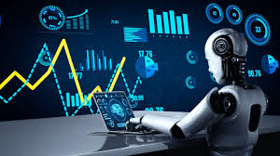
Machine Learning & Deep learning
Sara Mihandoost

Slide 2
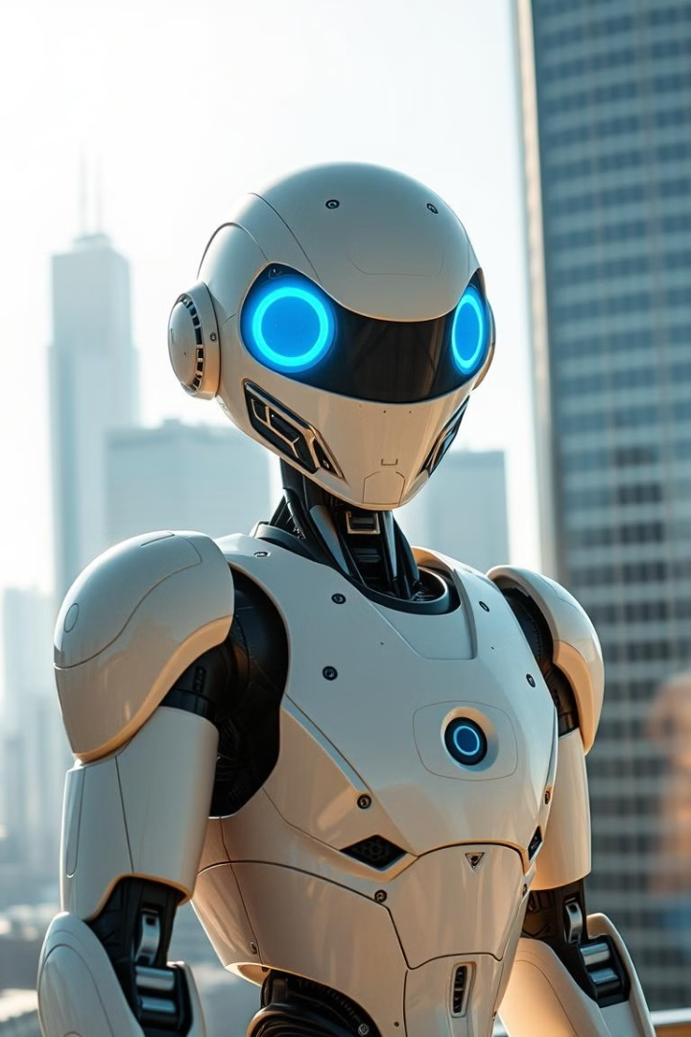
What is Artificial Intelligence (AI)?
AI is the simulation of human intelligence processes by computer systems. These processes include learning (the acquisition of information and rules), reasoning (using rules to reach approximate or definite conclusions), and self-correction.

Slide 3
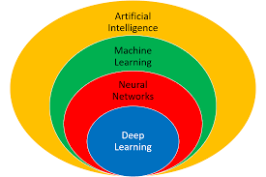
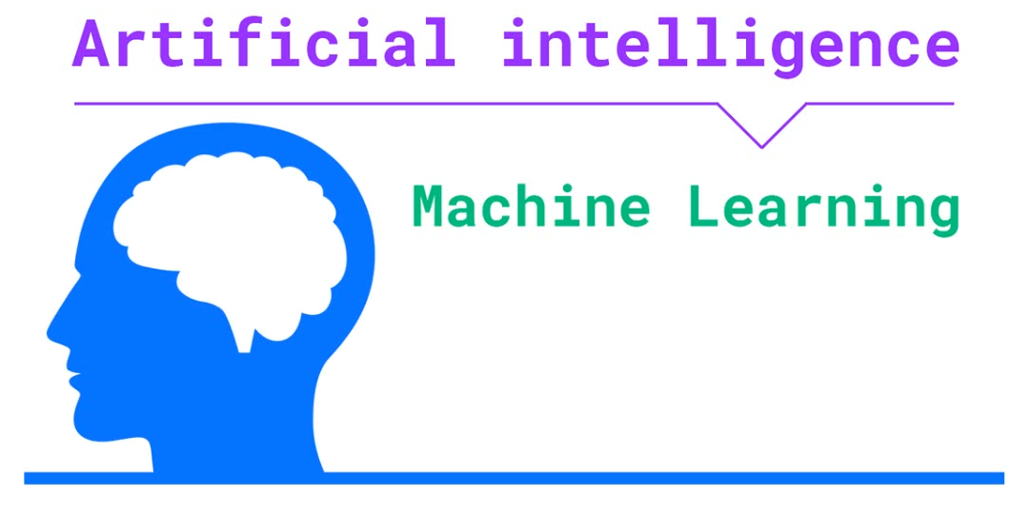
Artificial Intelligence
AI (mimics of human I
ML (Subset of AI, more statistical)
DL (Revolution in ML)

Slide 4
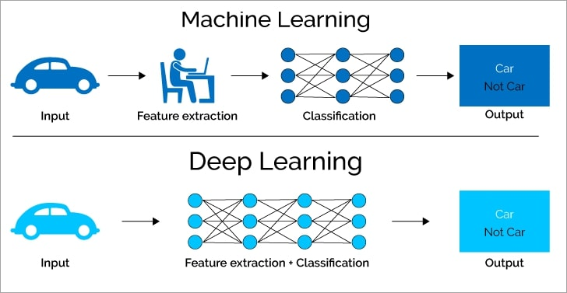

Slide 5
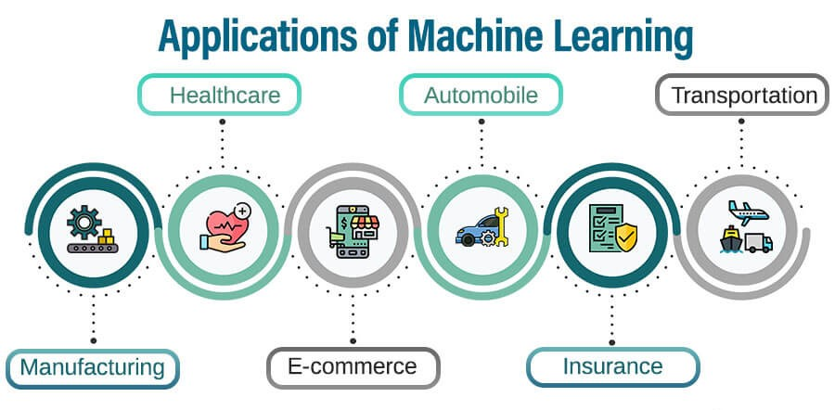
Machine Learning
Real-World Applications of AI and Machine Learning
AI and ML are transforming industries across the globe, bringing about efficiency, automation, and personalized experiences. Their applications are wide-ranging, from healthcare and finance to transportation and entertainment.

Slide 6
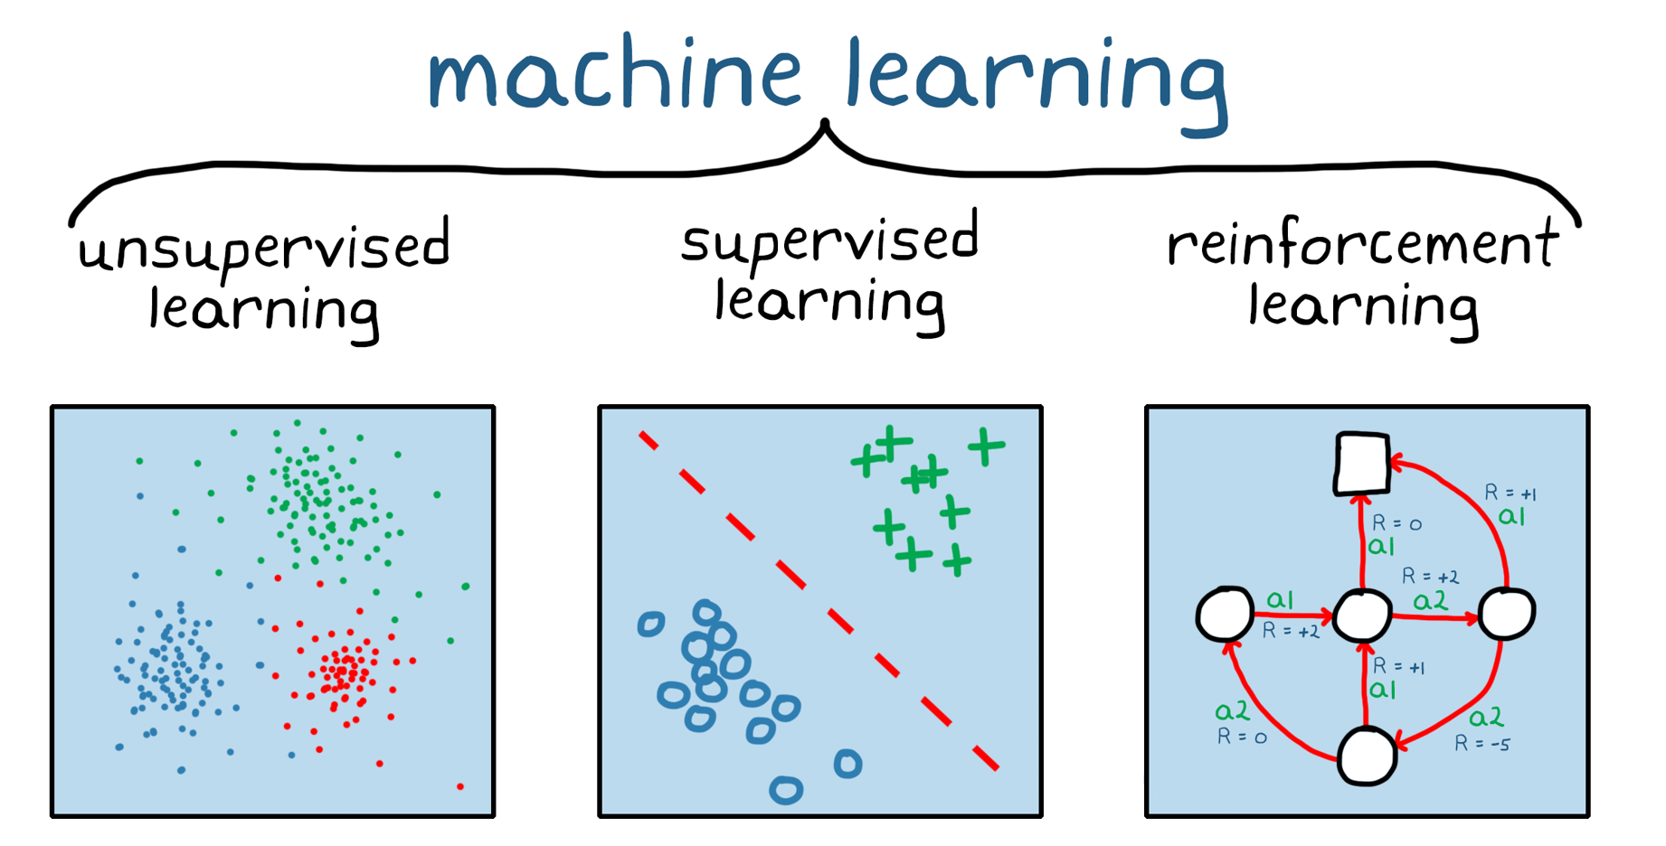
Machine Learning
Algorithms and Techniques

Slide 7
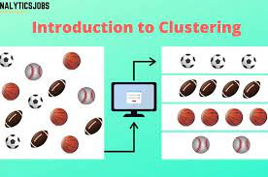
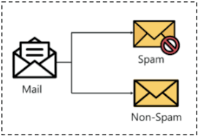
Machine Learning
Supervised vs. Unsupervised
Supervised:
Classification
Regression
Unsupervised:
Clustering

Slide 8
Machine Learning

Slide 9
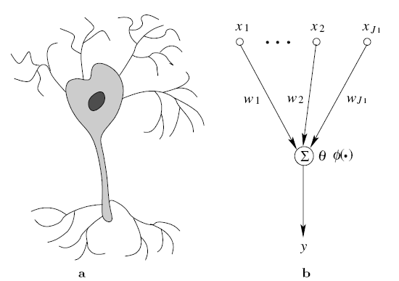
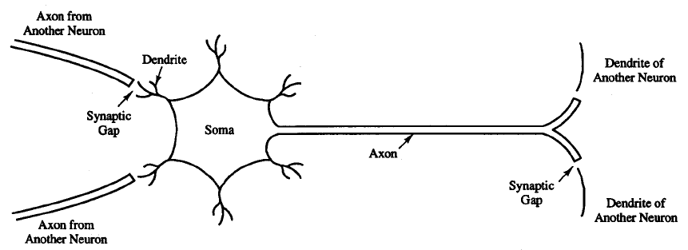
Artificial Neural Networks

Slide 10
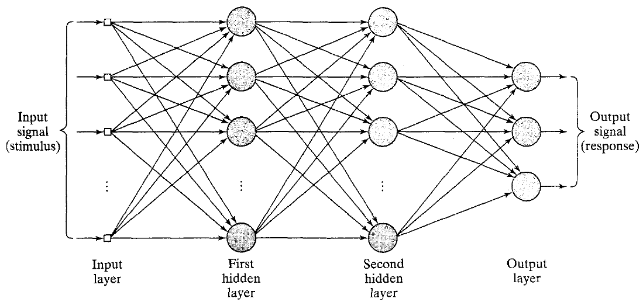
Artificial Neural Networks
MLP

Slide 11
Deep Learning

Slide 12
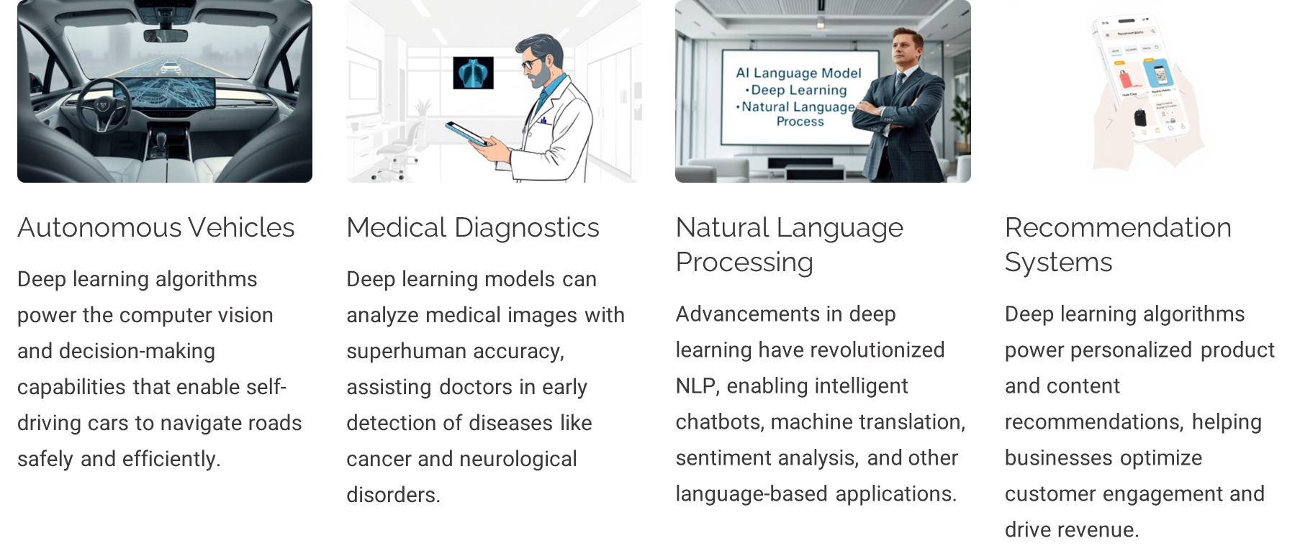
Deep Learning
Neural Networks and Applications

Slide 13
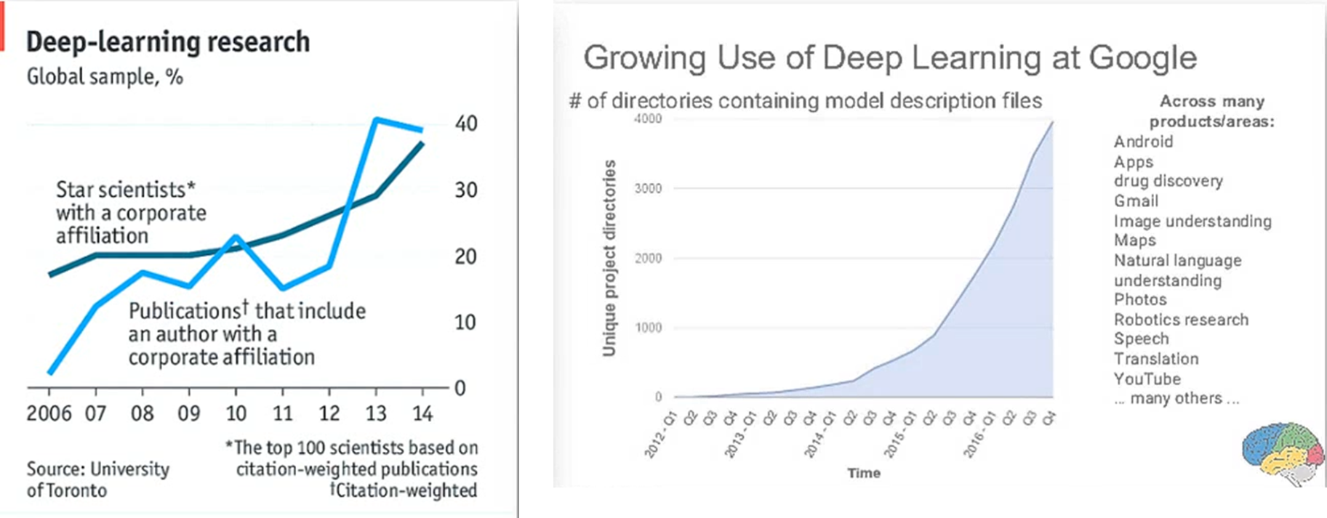
The Popularity of Deep Learning

Slide 14
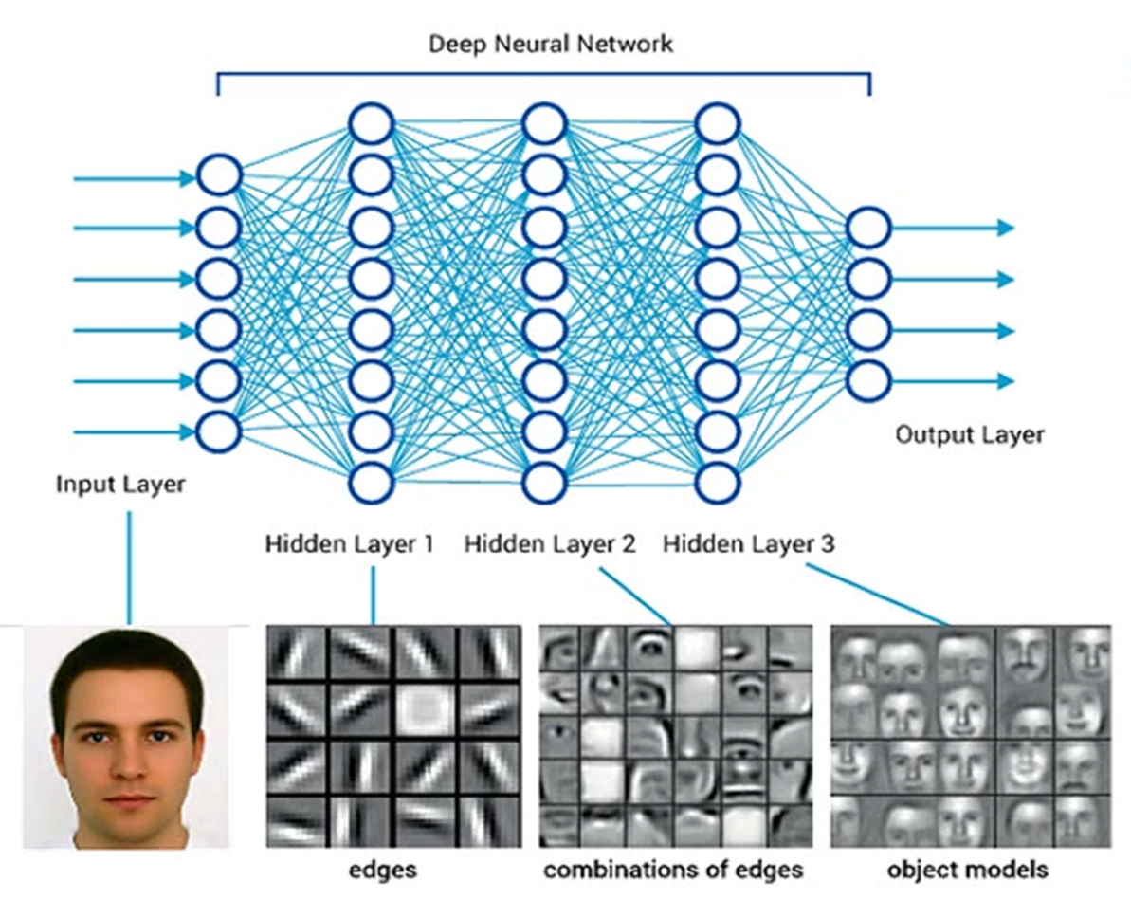
Deep Learning

Slide 15
Deep Learning
Convolutional Neural Networks

Slide 16
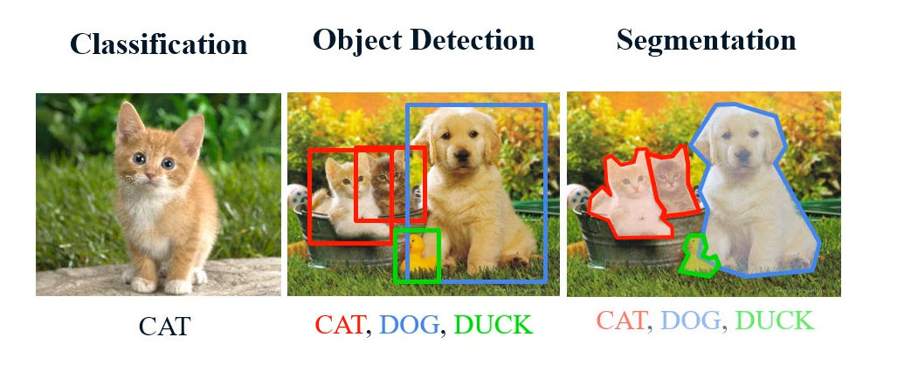
Deep Learning
Convolutional Neural Networks

Slide 17
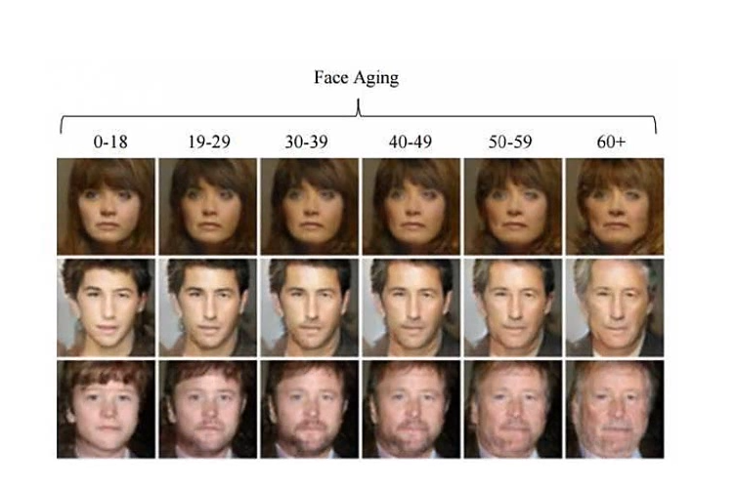
Deep Learning
Generative Adversarial Networks

Slide 18
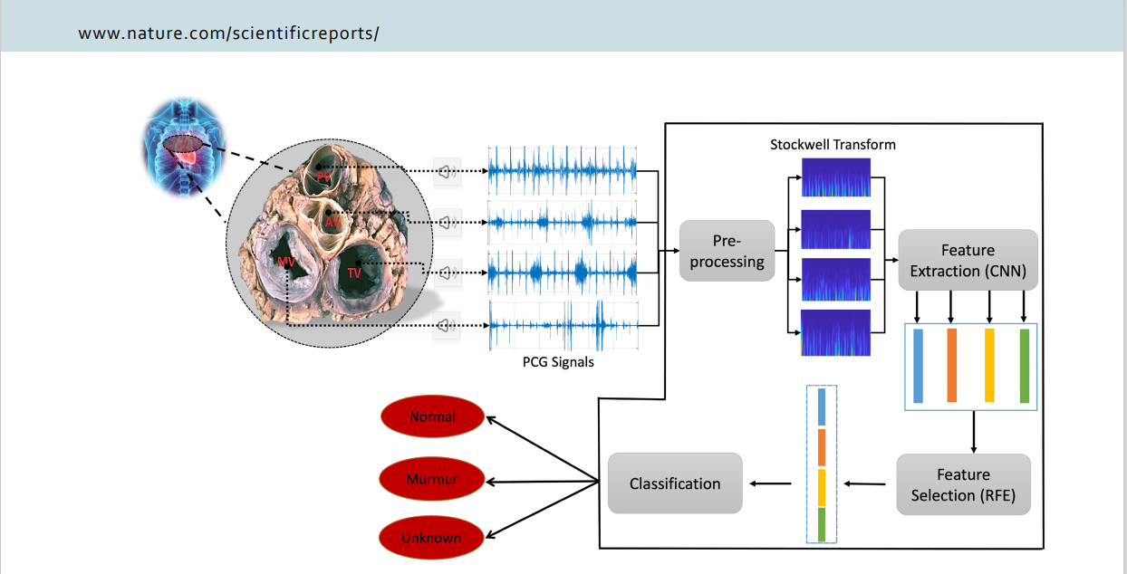
Deep Learning
Hybrid

