Slide 1
Power Engineering
Existence and the goals

Slide 2
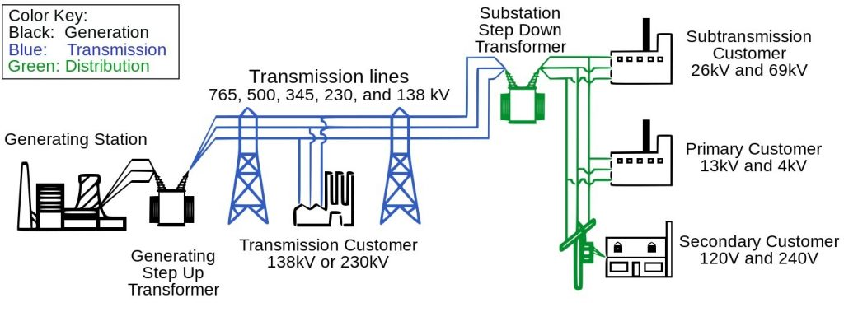
Power system structure

Slide 3
Branches of power engineering
Power systems
Power electronics
Electrical machines
Energy management

Slide 4
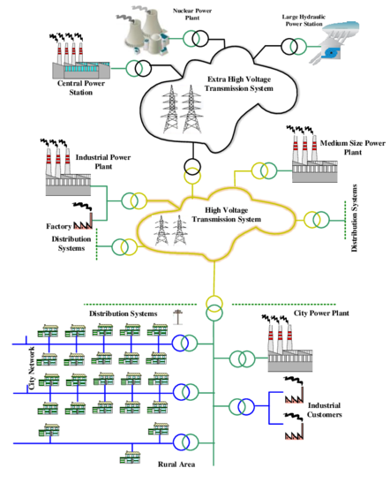
Branches of power engineering
Power systems
Power system planning

Slide 5
Branches of power engineering
Power systems
Power system operation

Slide 6
Branches of power engineering
Power systems
Power system protection

Slide 7
Branches of power engineering
Power systems
Power system dynamics

Slide 8
Branches of power engineering
Power systems
Active / Reactive power

Slide 9
Branches of power engineering
Power systems
Renewable energy

Slide 10
Branches of power engineering
Power systems
Plug-in hybrid vehicles (PHEV)

Slide 11
Branches of power engineering
Power systems
Smart grids

Slide 12
Branches of power engineering
Power systems
Micro grids

Slide 13
Job positions
Generation
Transmission
Distribution
Building (design and supervision)
Inverters
Energy management
…..

Slide 14
Useful software
ETAP

Slide 15
Useful software
DigSILENT

Slide 16
Useful software
PSS

Slide 17
Useful software
PSCAD

Slide 18
Useful software
MATLAB (Simulink & mfile)

Slide 19
Useful software
DIAlux

Slide 20
Useful software
AutoCAD

